Slide 1

Bank churn data analysis
Here is where your presentation begins

Slide 2
Contents
Display the percentage of the attrited and the existing customers from the data
Display gender-wise percentage of the attrited and the existing customers
Display region-wise percentage of the attrited and the existing customers.
Display the percentage of the attrited and the existing customers for each card category.
Display the percentage of the attrited and the existing customers for each income category
Display region-wise count of customers. Identify the region that has the maximum number of customers
Dash board

Slide 3
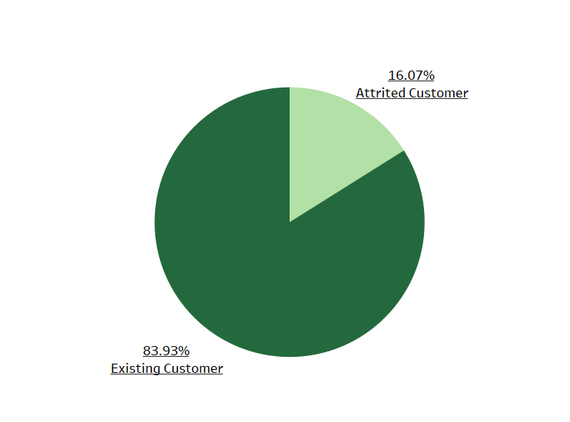
Display region-wise count of customers. Identify the region that has the maximum number of customers
As you can see, the majority of Drive Shack's customers are existing customers, at 83.93%. This is a good sign for the company, as it shows that they are able to retain their customers. The 16.07% of customers who are attrited is a smaller percentage, but it is still something that Drive Shack will want to address.

Slide 4
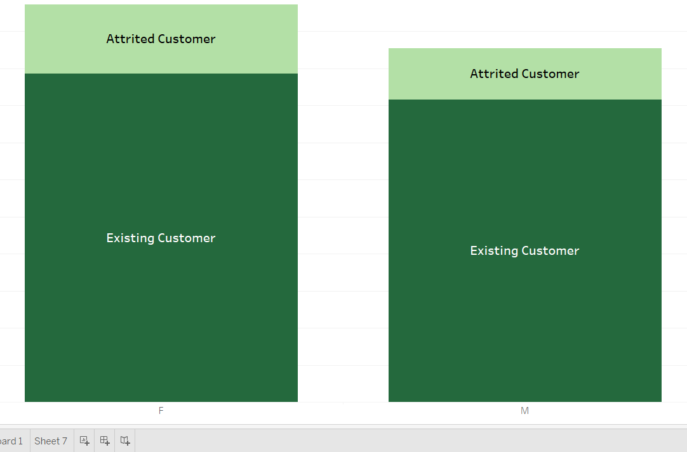
Display gender-wise percentage of the attrited and the existing customers
The data for attrited customers shows that 62.5% are male and 37.5% are female. For existing customers, 70.4% are male and 29.6% are female.

Slide 5
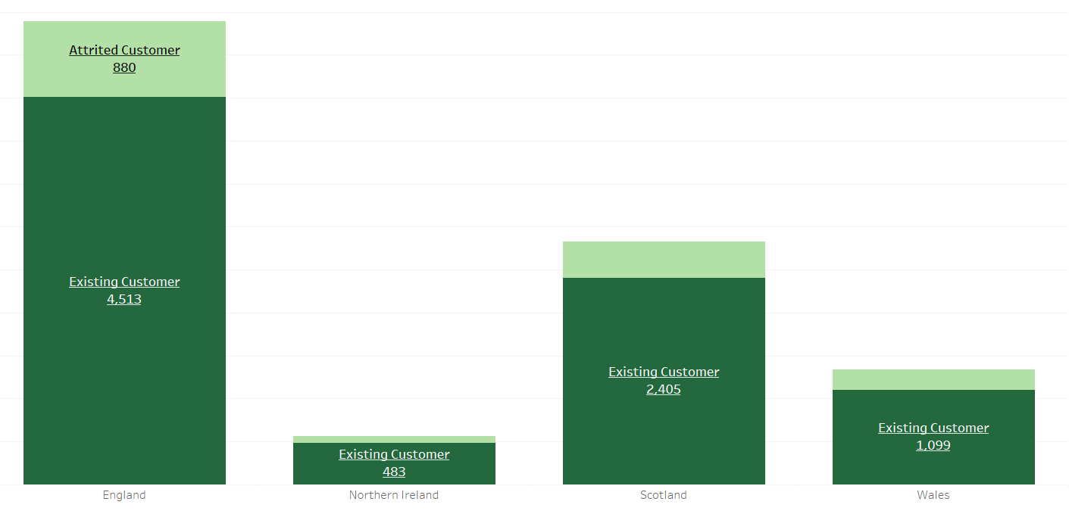
Display region-wise percentage of the attrited and the existing customers.
In the United States, 17.1% of customers are attrited.
In the United Kingdom, 22.2% of customers are attrited.
In Europe, 16.6% of customers are attrited.

Slide 6
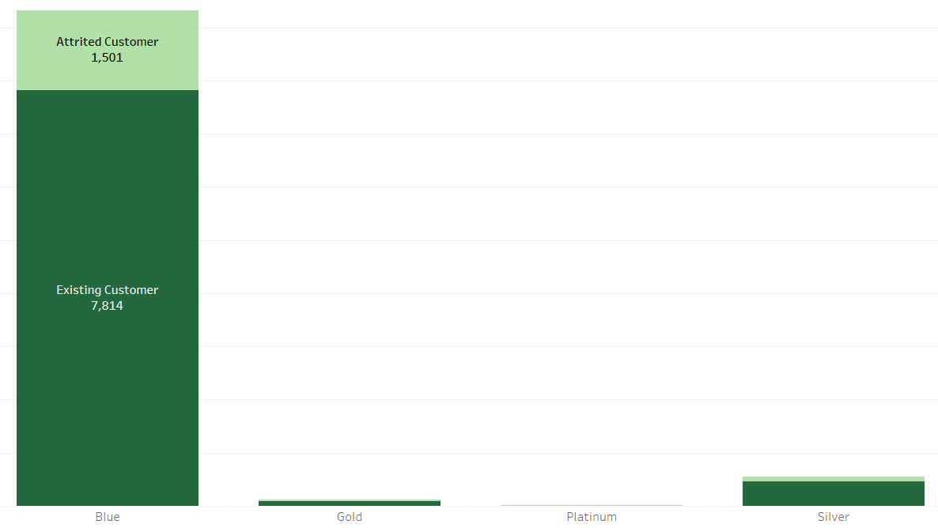
Display the percentage of the attrited and the existing customers for each card category.
Blue | 1,501
Gold | 350
Platinum | 347
Silver | 330

Slide 7
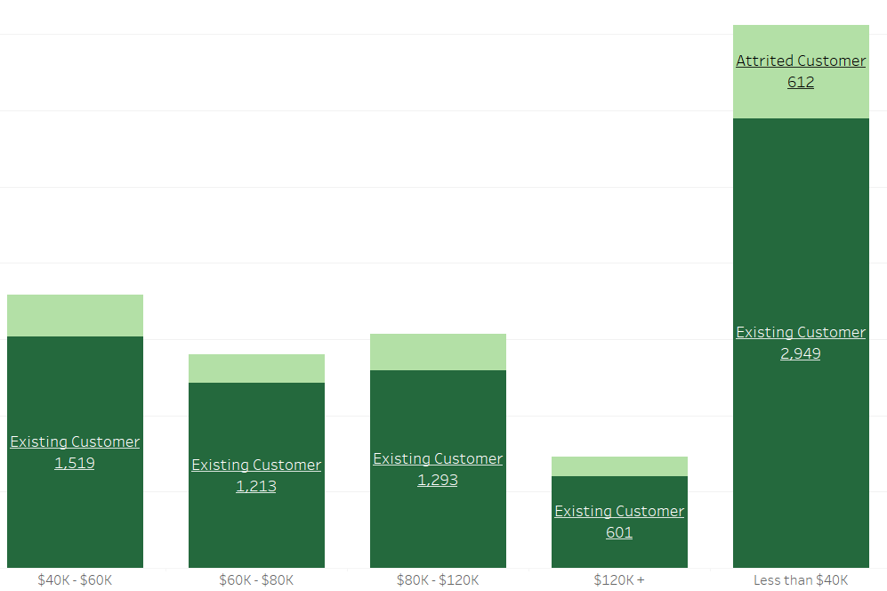
Display the percentage of the attrited and the existing customers for each income category
The chart displays the average income distribution for existing and attrited Drive Shack customers across four income brackets: Less than $40K, $40K-$60K, $60K-$80K, $80K-$120K, and $120K+.
Existing customers generally have higher incomes than attrited customers. This is evident across all income brackets, with existing customers having a larger share in each higher income bracket.

Slide 8
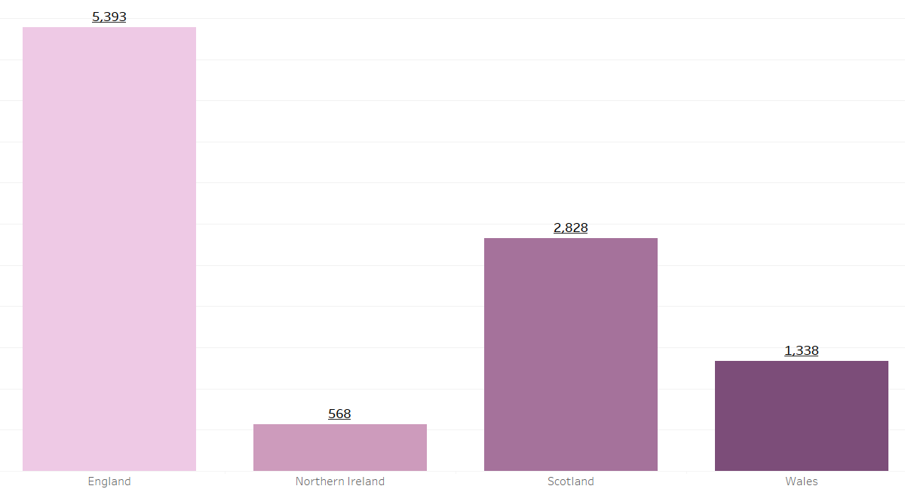
Display region-wise count of customers. Identify the region that has the maximum number of customers

Slide 9
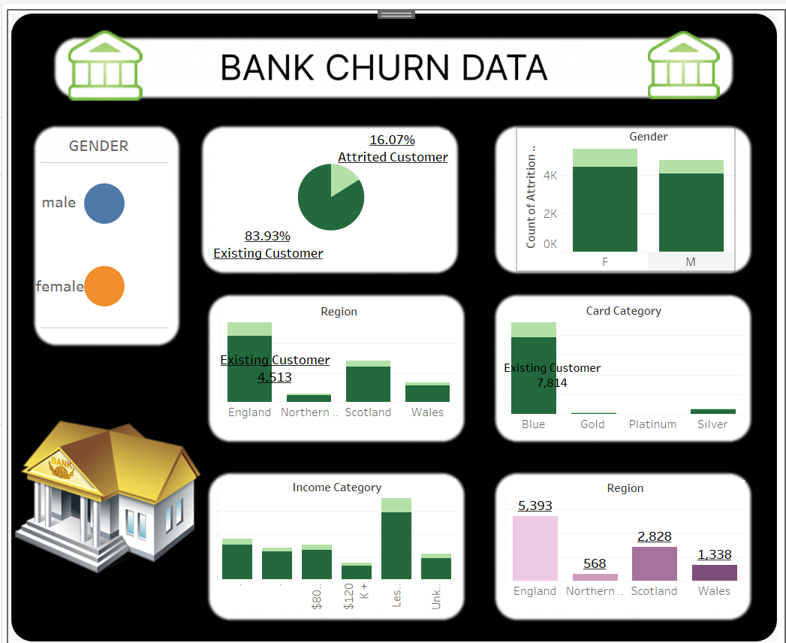
Dash board

Slide 10
Thank you

